Slide 1
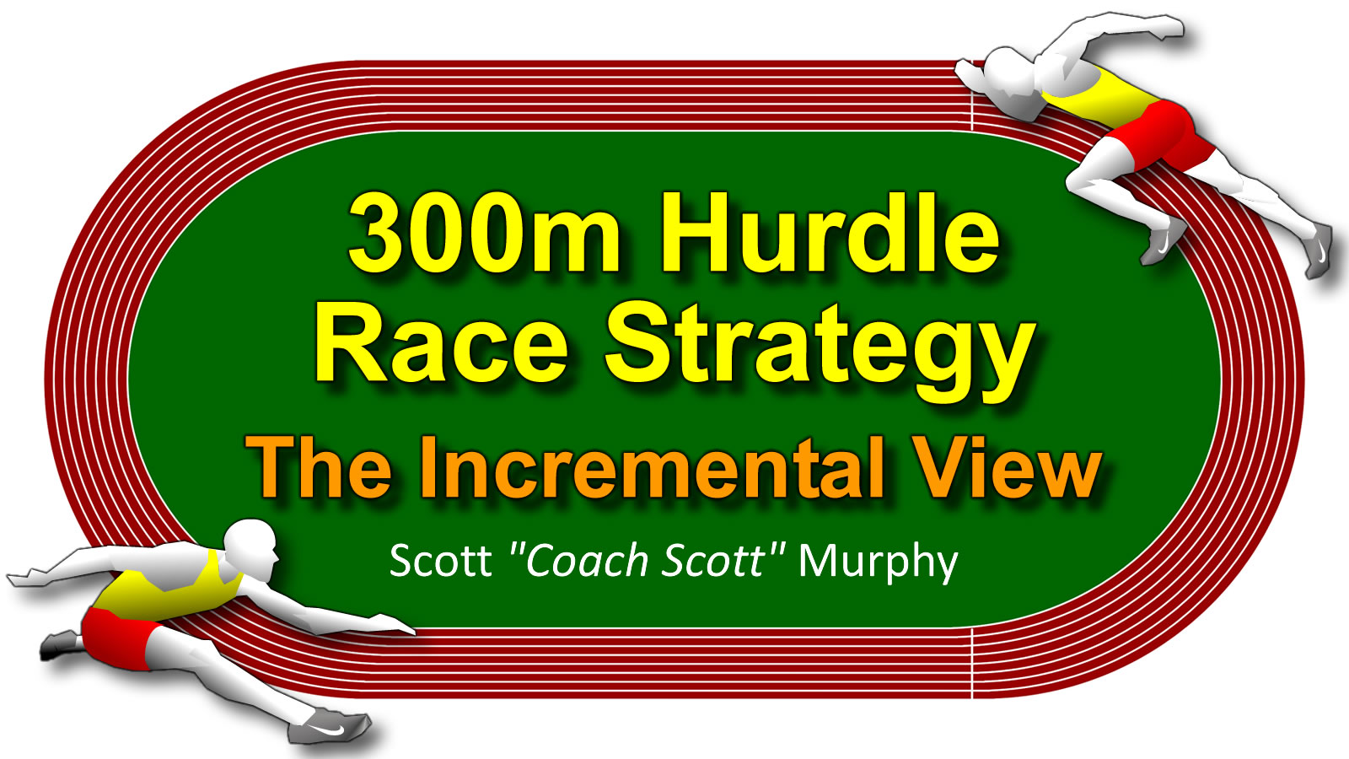

Slide 2
"Self-perception of high expertise increases closed-mindedness."
- Victor Ottatia, Loyola University
(AKA: I already know it all)

Slide 3
You Are The Expert
Your 300m Hurdle strategy ultimately depends on your conditions. Your athlete, your season, your experience and your goals.

Slide 4
What are the Strategies?
 | Short Term | Long Term
Mathematic | STM | LTM
Alternating | STA | LTA
Disastrous | STD | LTD

Slide 5
The “Coach Scott” Approach
This is how I do it now. It is not how I have always done it, and it will likely not be how I always do it. We learn, grow, and improve.

Slide 6
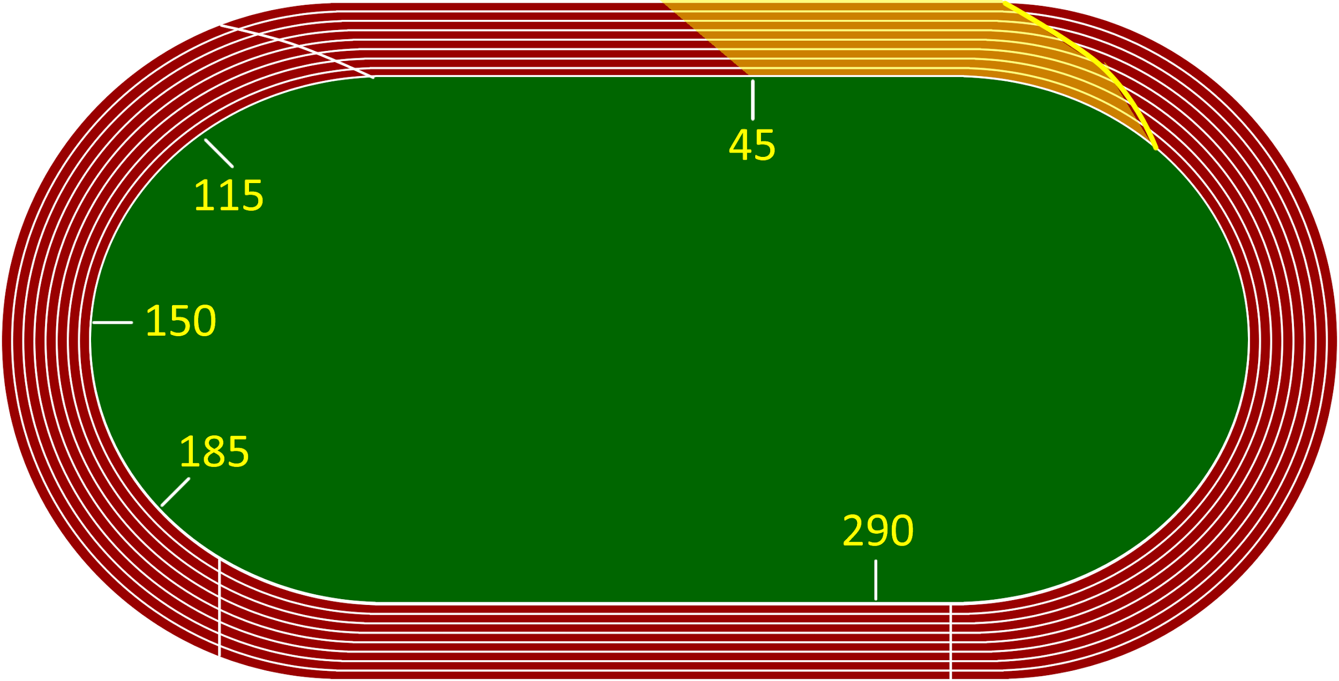
The Start.
Be a sprinter to the timed touchdown.

Slide 7
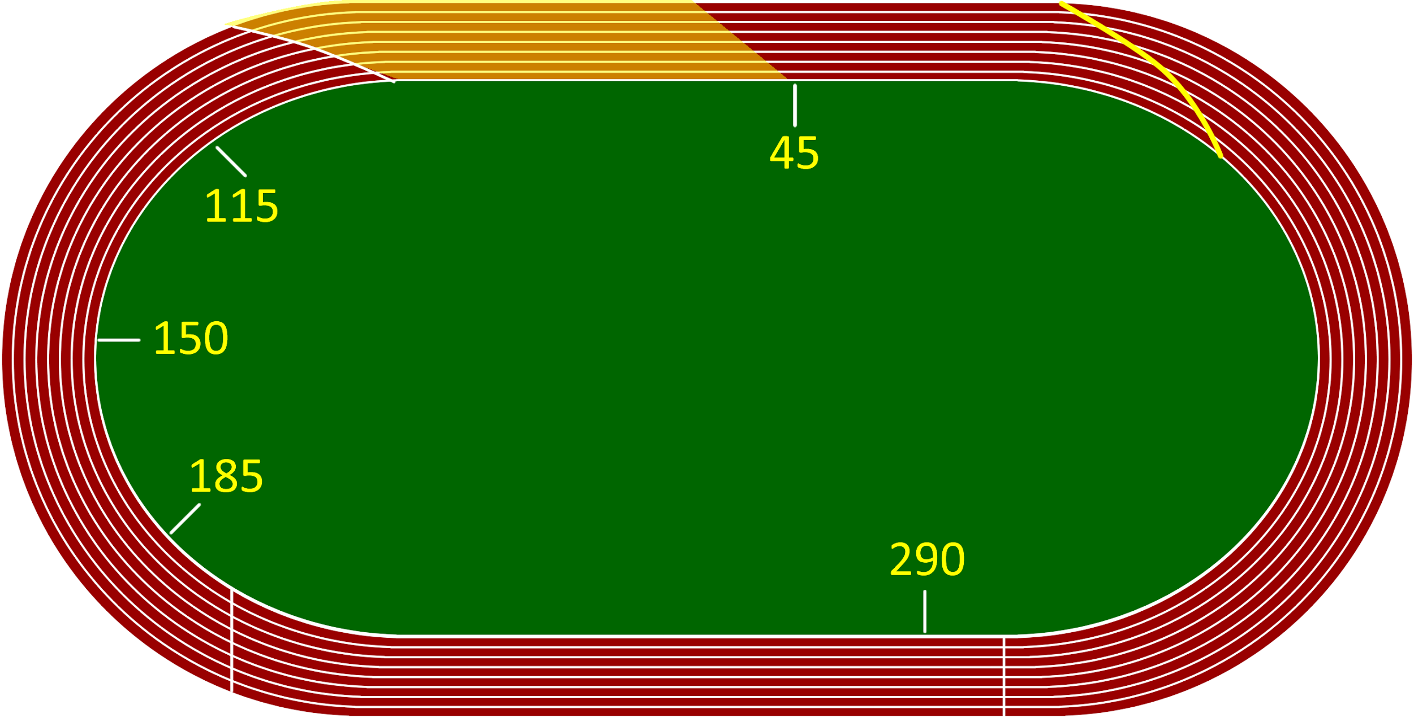
The Tempo.
Establish goal stride pattern, at planned tempo.

Slide 8
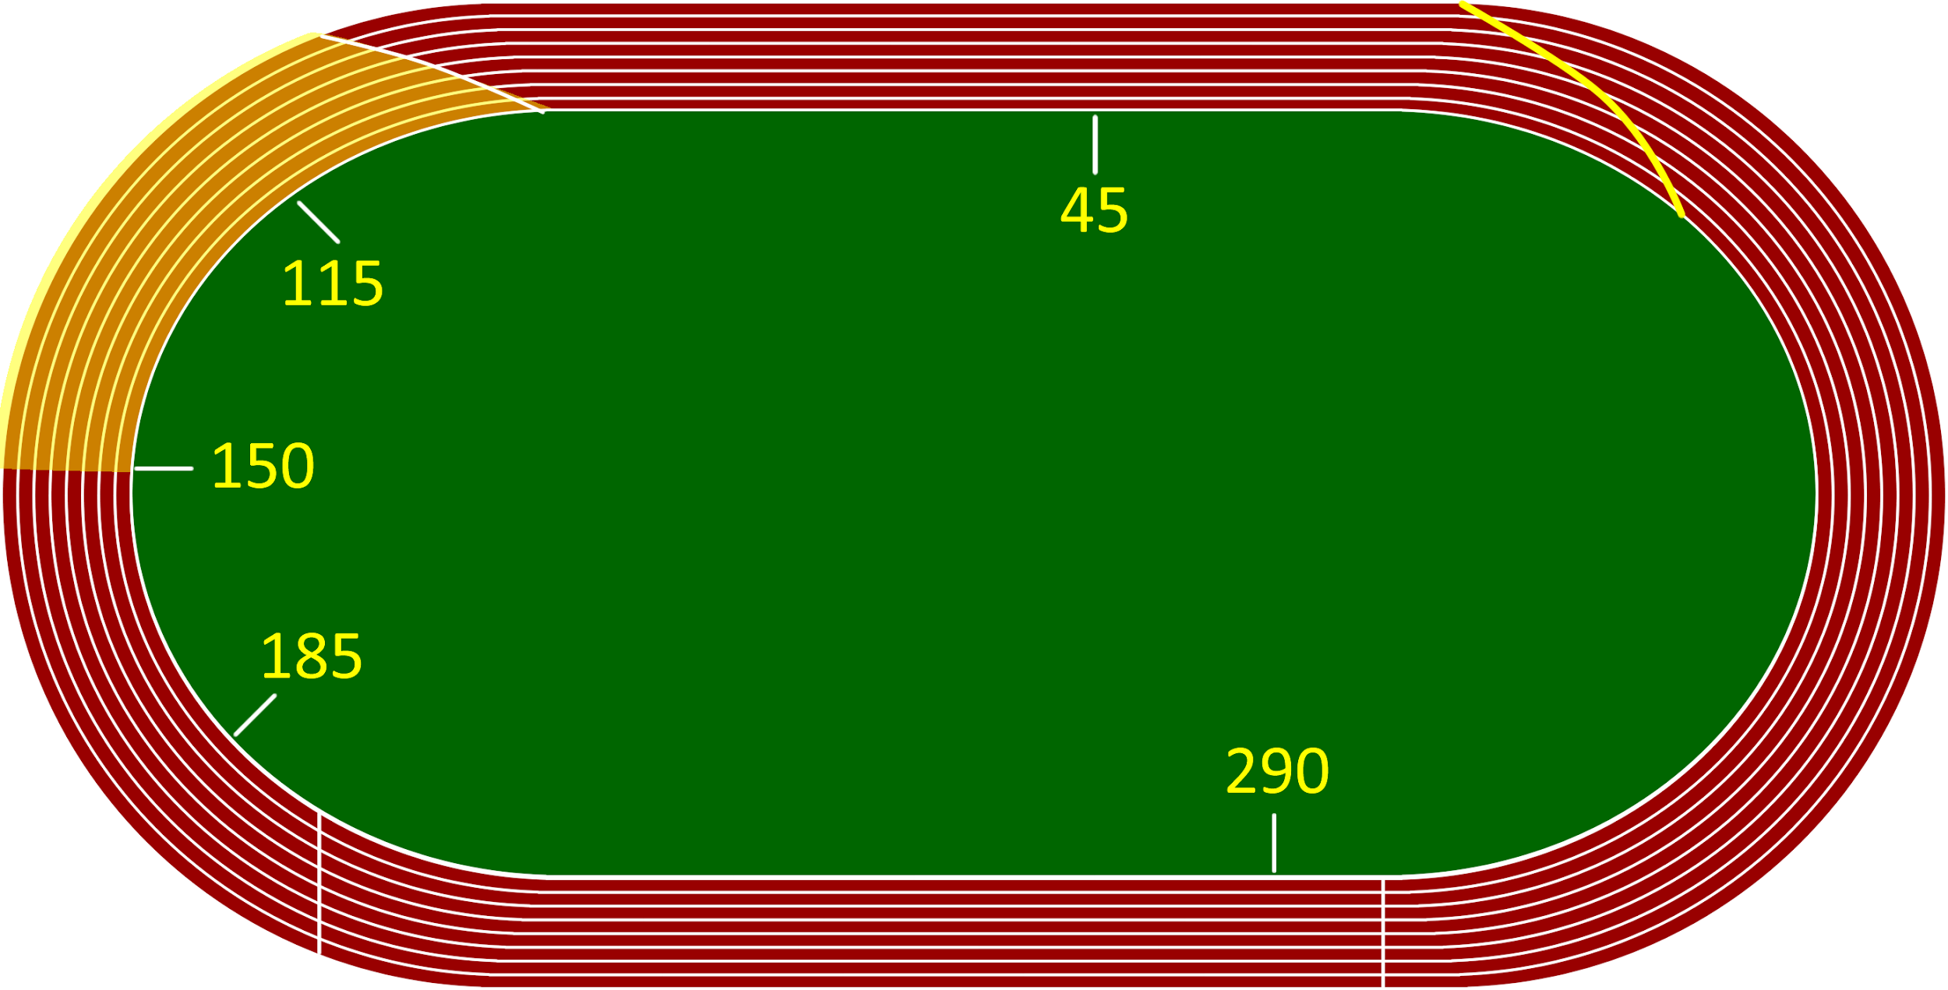
The Turn.
Attack the turn, on the inside, maintaining goal stride pattern.

Slide 9
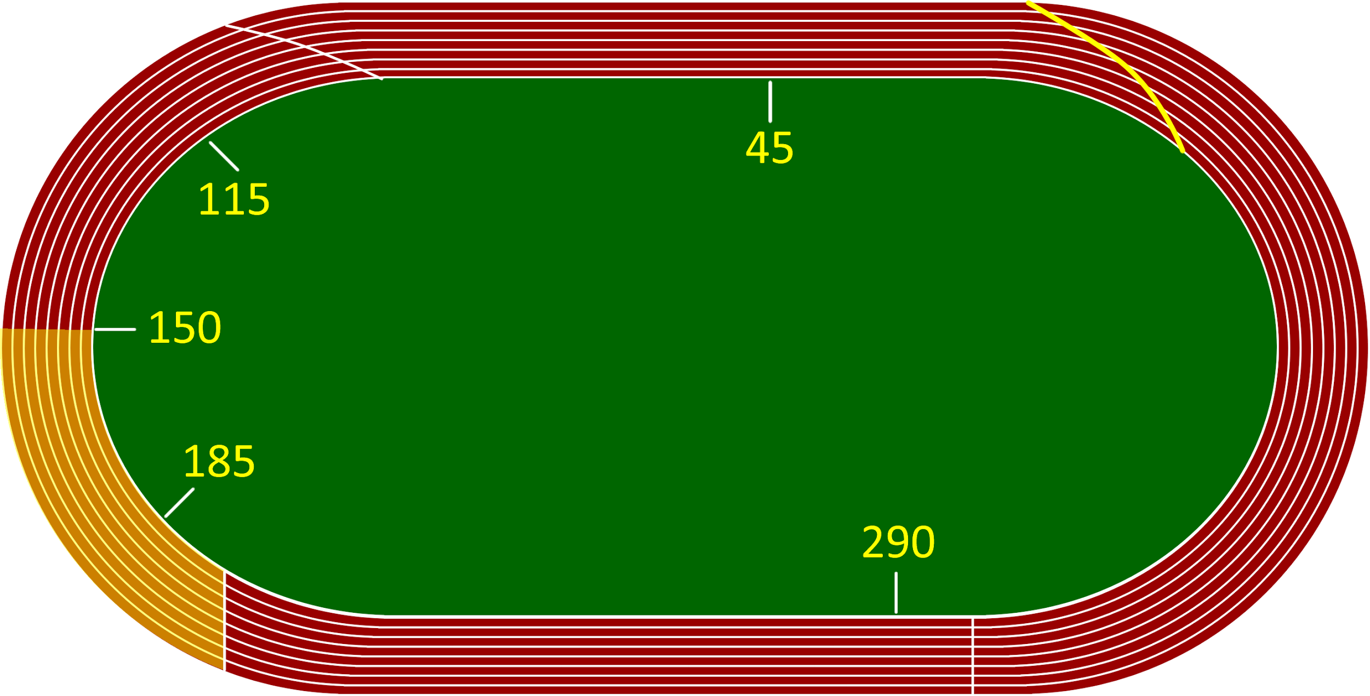
The Ugly Hurdle.
Stay in attack, on inside of lane. If an adjustment is needed, this is usually the alternate leg.

Slide 10
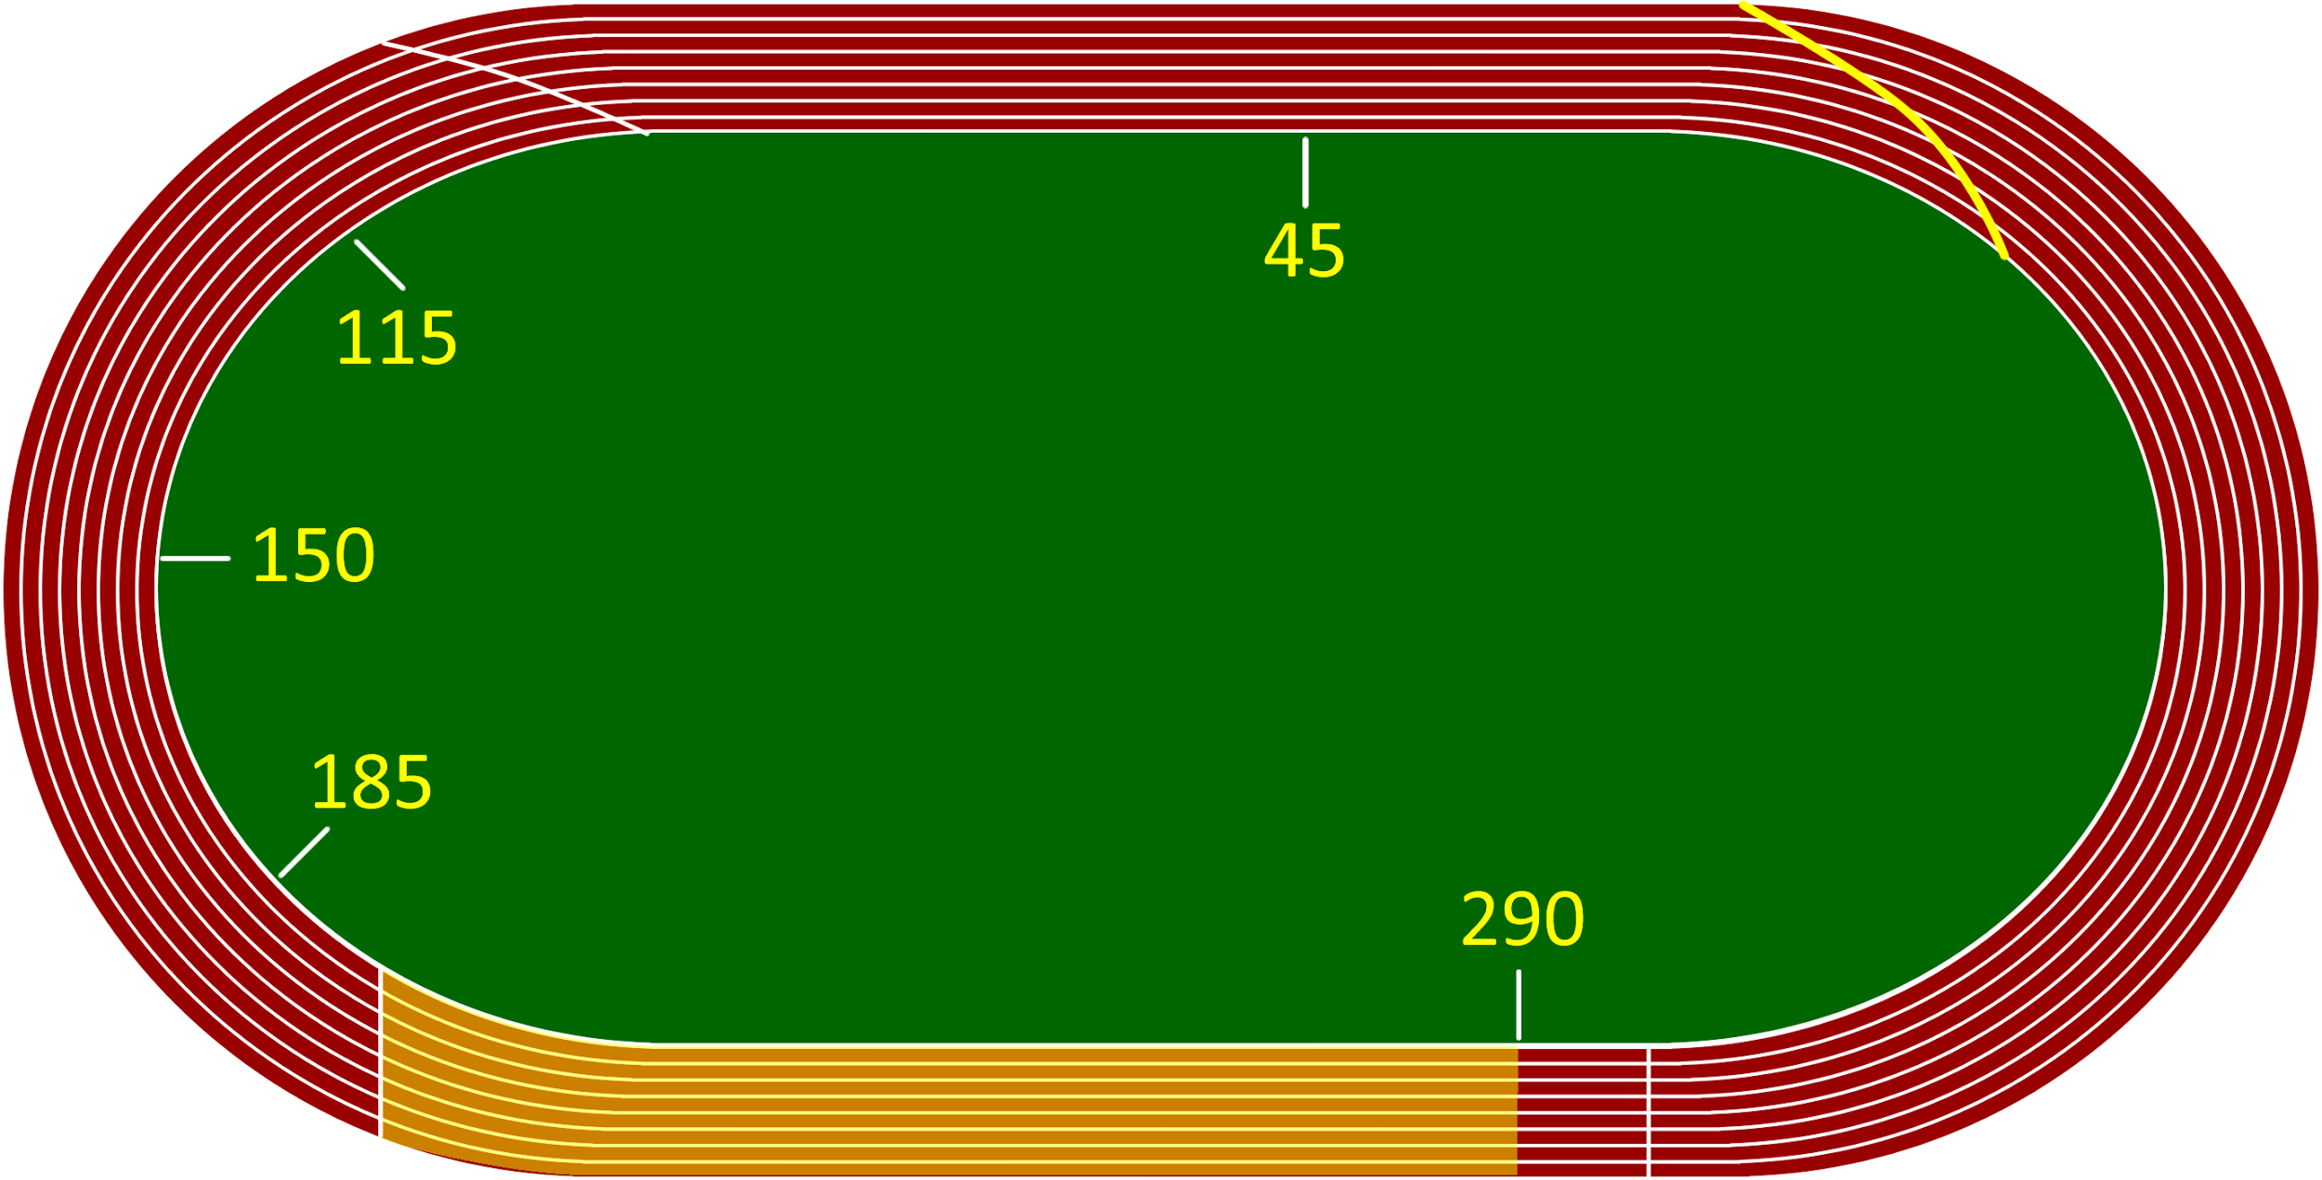
The Stretch.
This is where the discipline from practice pays off. Stick with the plan. We know it hurts.

Slide 11
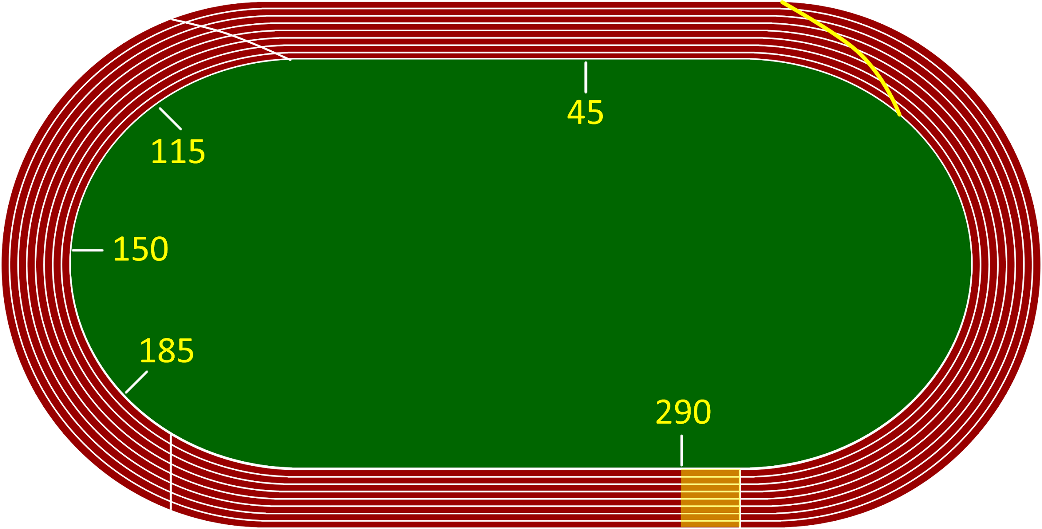
Hurdle 8.
Come off of this hurdle hard (we practice accelerating off of this hurdle a lot).

Slide 12
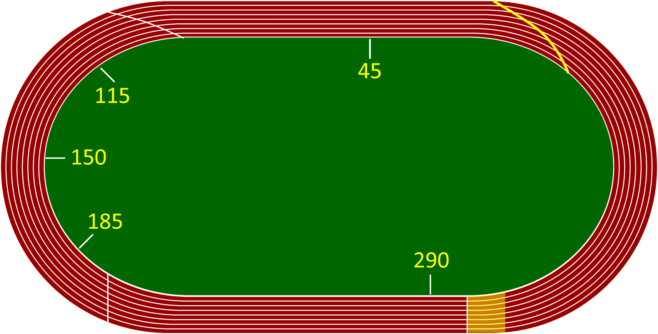
The Finish.
We never train to the finish line. Our target is the end of the exchange zone.

Slide 13
You Are The Expert
No two of our hurdlers are the same. Our strategy should not be a one-size-fits-all approach.
Our athletes deserve our best.

Slide 14


